Slide 1


Operating Manual (Eng. Ver)

Slide 2

Logo and App Face

Slide 3
Color Coding
Animation
General Explanation
Back button

Slide 4
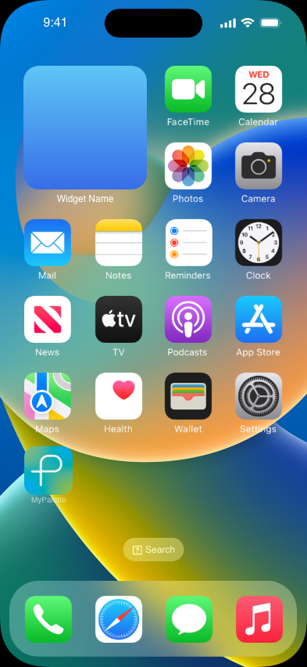
Accessing the System
To access, a user would download “MyPalette” from the app store

Slide 5
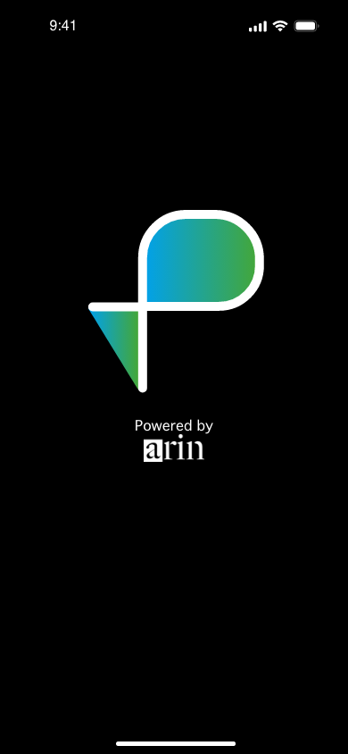
Loading Screen
Loading Screen

Slide 6
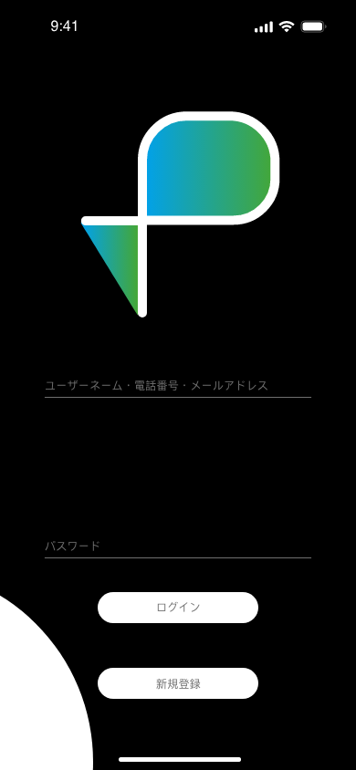

Log-In (Via website)
When the user tries to log-in, they are flown to a website where they can log-in.
When a user types in their log-in info, the text turns white and larger. Then the user would press log-in to log-in.
The white circle (circled in red) comes in from the bottom left. Everything else diffuses in.

Slide 7

Log-In
If the user’s information is incorrect, the red text appears:
「記入したパスワードかユーザーネームがありませんでした」

Slide 8
Signing Up
A new user would press “Sign Up” or 「新規登録」and sign up

Slide 9
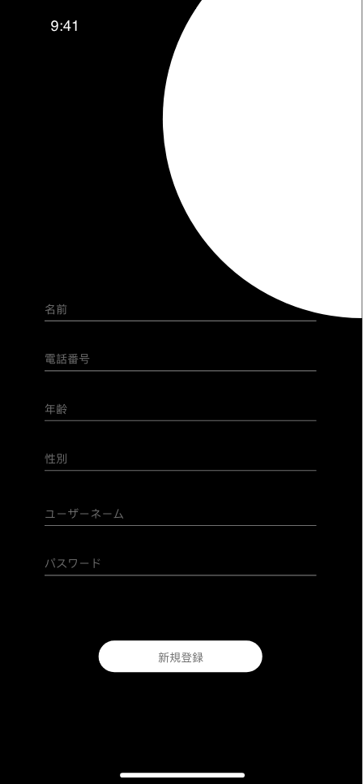
Signing Up
White circle come in from top right, everything else diffuses in
Once the user presses “Sign Up” or 「新規登録」they come to this page where they input their details
Users would input their name, phone number, age, sex, username, and password
After that’s done, and if there are no issues with the input, the user would press Sign Up
After Sign Up, the top right circle moves away to the top right, everything else slides to the left and the screen turns dark and transitions to the home page

Slide 10
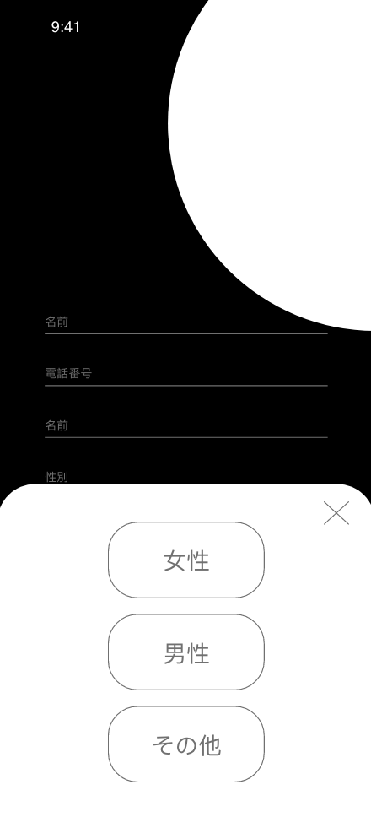
Signing Up — Sex Button
White box slides up from the bottom.
When user presses ”X” the box slides down
When a user presses the “Sex” section to select their sex, 3 options pop up: female, male, and others.
When the user presses “X” the pop up goes down
The selected sex appears in a white text, bigger than the gray small text

Slide 11
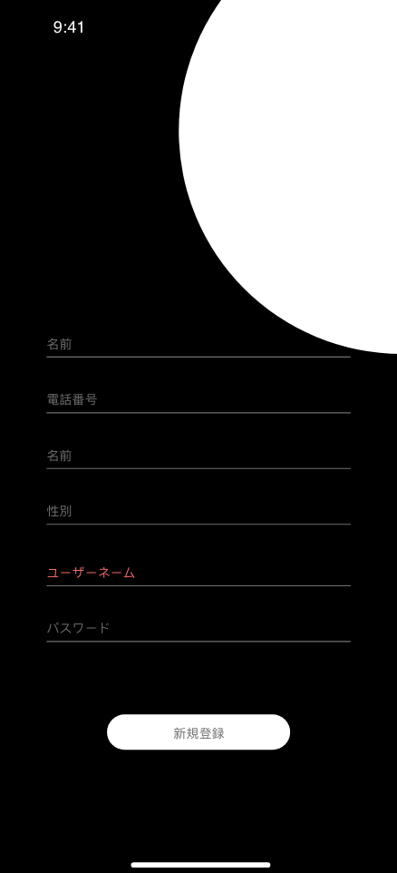
Signing Up — Error
If there is an issue with the information, or if theuser name is already taken, the text turns red from gray

Slide 12
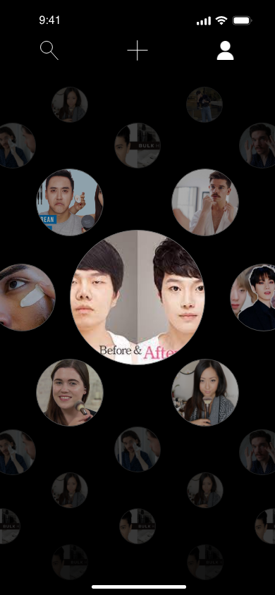
Home Screen
As you go closer to the center, the more fit towards the users preference.
The further away from the center you go, uncharted content appears
Similar to the home screen of an apple watch, users can move around. As they move around, the shades and the sizes of the circle changes
Constantly, the middle has the brightest and biggest circle, while the outer circles have smaller and darker shades
When a user clicks one circle, they fly to the content page

Slide 13



Home Screen — Navigation
Button to fly to users profile page
Button to fly to content upload page
Search Button

Slide 14
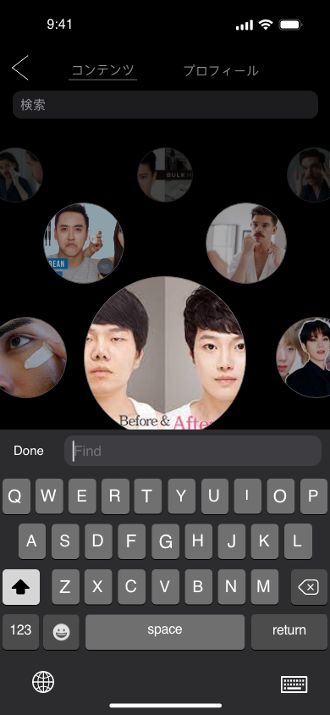
Search Function
Search page slides in from right to left
Users would input product names, content types, trends and the content most fit to the term shows up
Users can pick between looking for content fit to the search or look for profile fit to the search

Slide 15
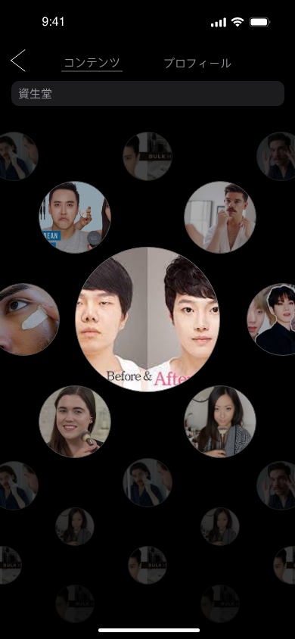
Search Function — Content Search
No animation, just loads new content
The closer to the middle, the more fit the content is to the search. If two content is similar in how fit it is, the order depends on the number of reactions and the more views.
If the user is searching for content, the page is displayed similar to the home screen

Slide 16
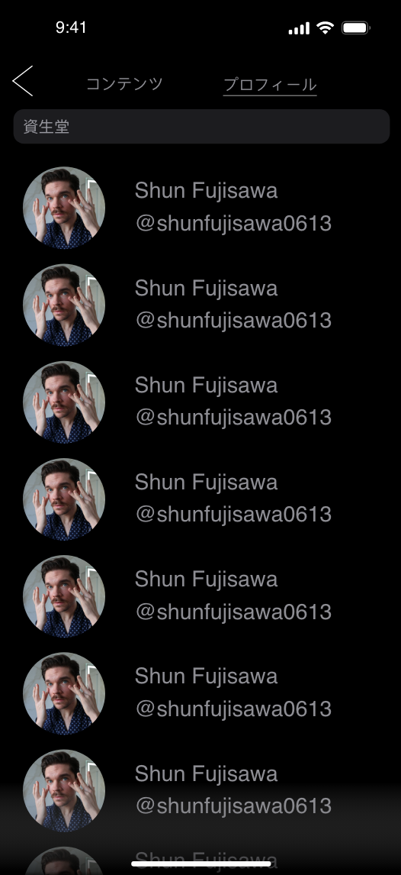
Search Function — Profile Search
Show a list of profiles
Display the profiles in order of how fit the name or username is to the searched term
As the user slides up, the page goes down and displays more of the list
Add a black gradation at the bottom

Slide 17
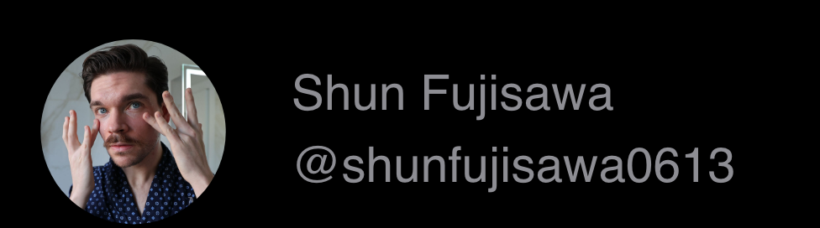
Search Function — Profile Search
Show the users profile picutre, name, and username (tag)
When a user pushes the users profile picture, name, or username (tag), the screen goes to the selected user’s profile page
The profile page slides in from the right

Slide 18
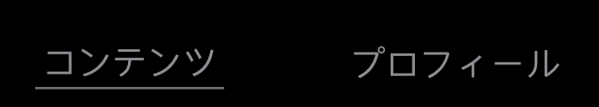

Search Function — Buttons
Users can pick between looking for content fit to the search or look for profile fit to the search using this button
The gray underline moves based on the selected button
*As defult, the content is shown first
Go back to the main page from the search page
Search page slides to the right

Slide 19
Search Function — Profile Search
Show a list of profiles
Display the profiles in order of how fit the name or username is to the searched term
As the user slides up, the page goes down and displays more of the list
Add a black gradation at the bottom

Slide 20
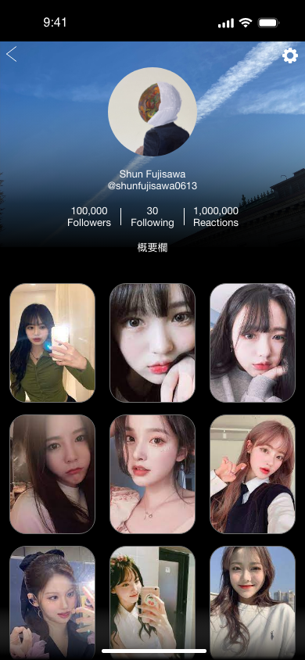
Profile Page
Slide in from the right to the left
Slide to the right when going back
Add a black shade over the background image
Users can tap on the content images once to replay the live photo
Double tap and users can watch the content in full screen
-> content page
Once a user watches the content in full screen, they can scroll up and down and scroll between all the profile page’s content
(Like TikTok)

Slide 21
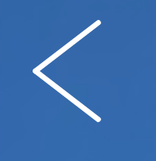

Profile Page — Buttons
Back Button, goes to the main page (if flown from the main page)
Goes to the search page (if flown from the search page)
Goes to the content page (if flown from the content page)
Profile page slides to the right
Profile edit page

Slide 22
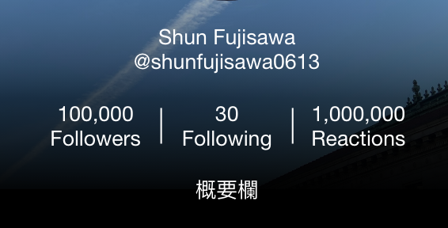
Profile Page — Details
Display:
Name
Username (Tag)
Followers, Following, and Total Reactions
Description

Slide 23
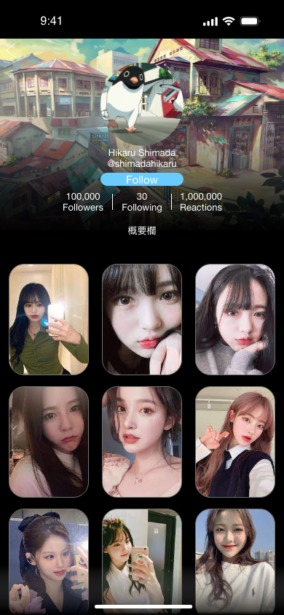
Profile Page — Looking at other users profile
Back button on the top left
Once the viewing user clicks “follow” the button changes to “following”

Slide 24
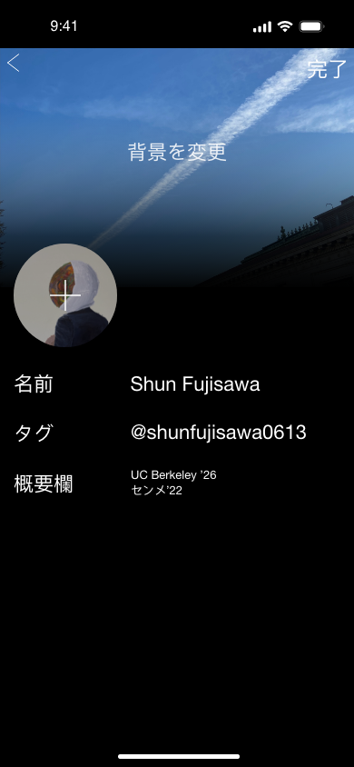
Profile Page — Editing
Slide in from right to left
Users can edit their profile picutre, background, name, username (tag), and description
When a user taps on the description, a keyboard comes up

Slide 25


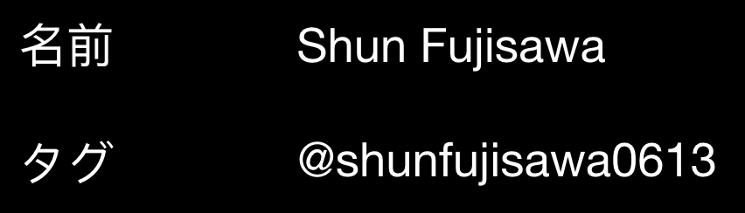
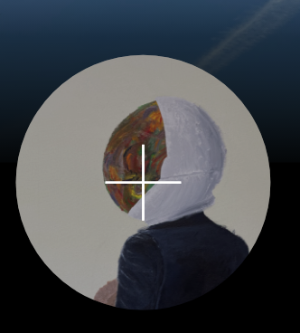
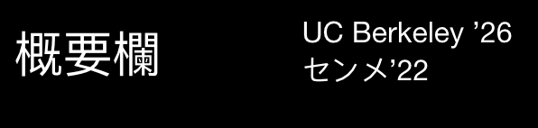
Profile Page — Editing (Buttons)
Save Button
Back Button (Goes to the profile page)
Edit page slides to the right
Button to edit the name and username (Tag)
When a user presses either one, the keyboard comes up
Button to edit the profile picture
The devices photo gallary opens
When a user clicks their description section, a keyboard comes up. When they tap somewhere other than the keyboard, it automatically saves

Slide 26
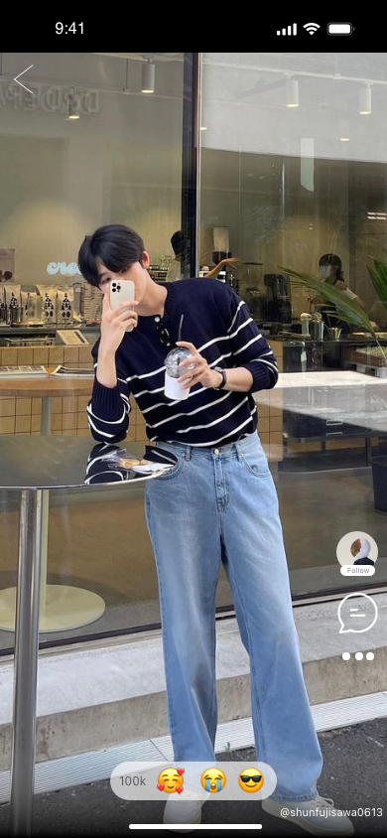
Content Page
One tap to play live photo
Scroll up and down to go to the next content or the previous content
Slide to the left to view table of products used in the content
Slide in from the right to the left

Slide 27
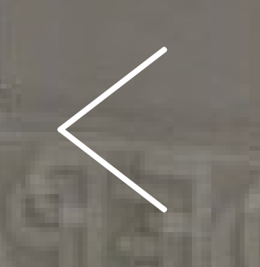
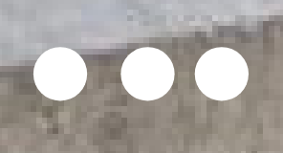
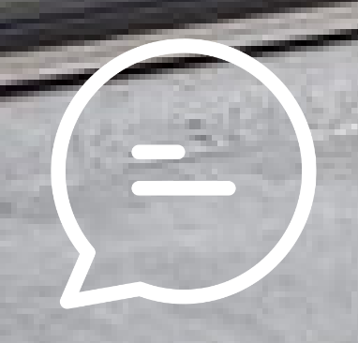
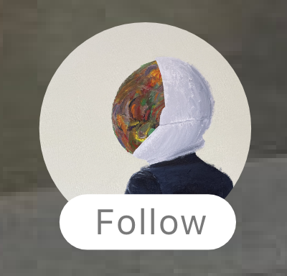
Content Page — Buttons
Back Button
Others Button
Opens Share, description, favourites, and satisfaction score,
Comment Button
Opens the comment section
Follow & Profile Button
Users can follow using this button and go to the content creator’s profile page
The profile page slides in from the right to the left

Slide 28
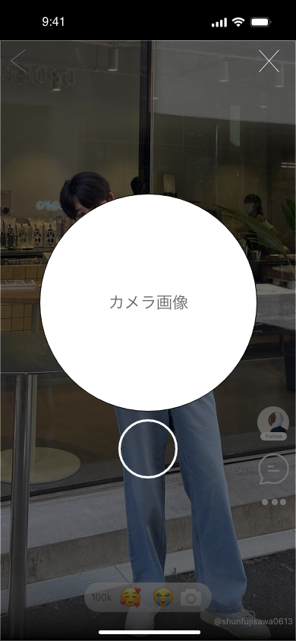
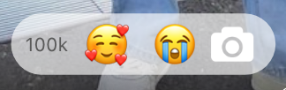
Selfie Reply (When users follow each other)
Users press the camera button to reply with a selfie
Slides up from the bottom
“X” to close the selfie screen (Slides down)
Press circle to take a selfie
Front camera live footage inside the big white circle
When a user takes a photo, the selfie screen goes down and the comment section comes up.
Users need to comment as well to post the selfie reply

Slide 29
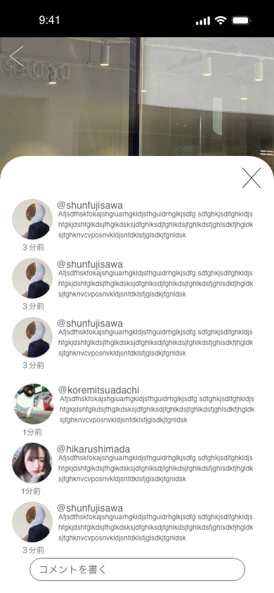
Comment Section
Slides up from the bottom
“X” Closes and comment section slides down
For thos replying with a selfie, the selfie replaces their profile picutre
Display how many minutes its been made

Slide 30
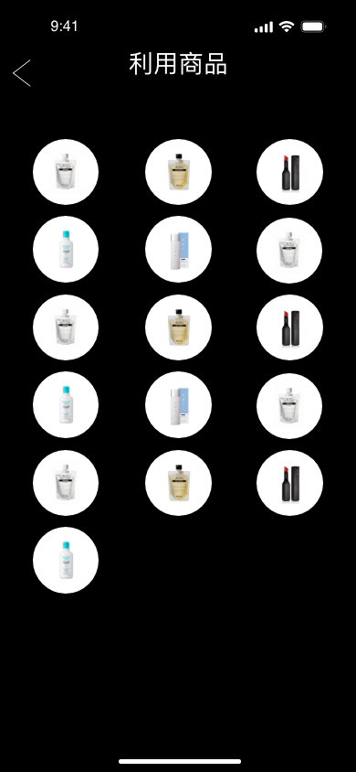
Product Space
Users slide left to view
Slide in fromt right to left
Slide to the right when going back
Back button on top left
Users can click on each circle to view product review
When they select a product to view its review, the outer ring
turns into a cyan (#0BFFDA)

Slide 31
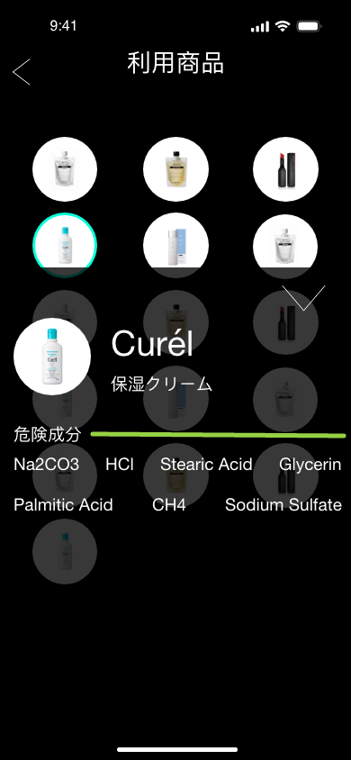
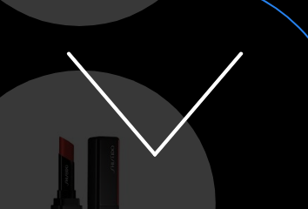
Product Space — Review
Company Name
Product Name
Slide Up
Users tap a circle to view the products details
Product photo, Product Name, Company Name, and dangerous substances are listed
The colored bar represent the danger level from green to red. Green being safe and red being dangerous. The number of dangerous substace determines how dangerous it is.
Users can press “保存” or “Save” to save the product in their favourites
When they press it, the text turns from white to gray and back when they release
Brings review down
Slide down

Slide 32
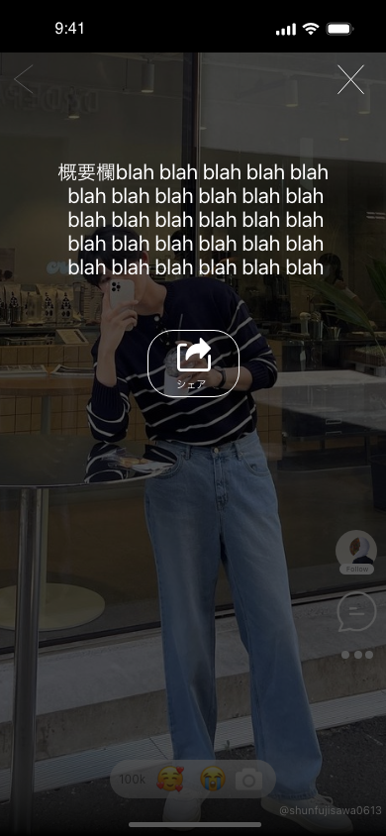
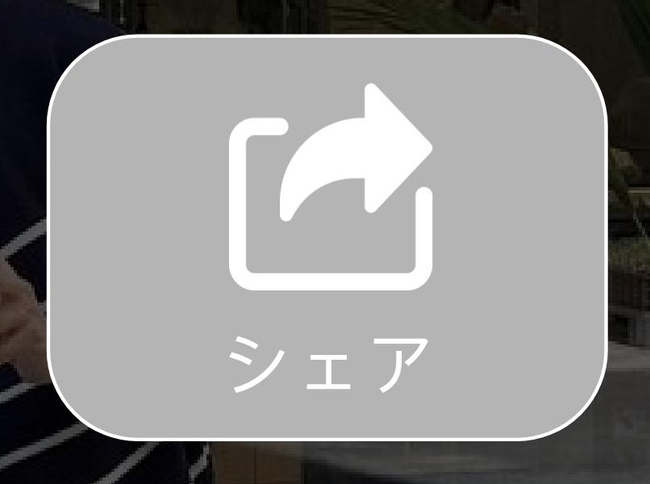
Others Button
Slide Up
When ”X” is pressed slide down
Share on the right hand side, when pressed share options come up
Description at the top
When a user presses the share or favourites button, the box turns gray for the duration in which they are pressing the button

Slide 33
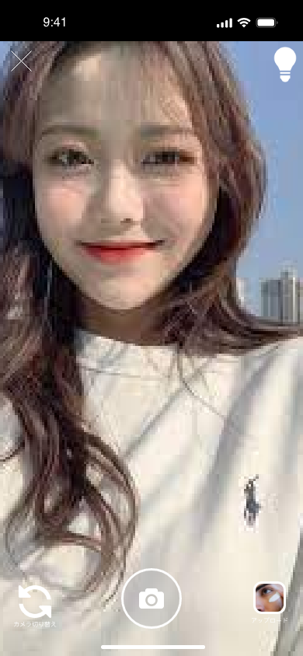
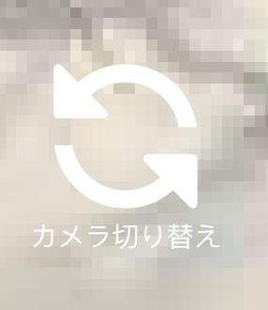

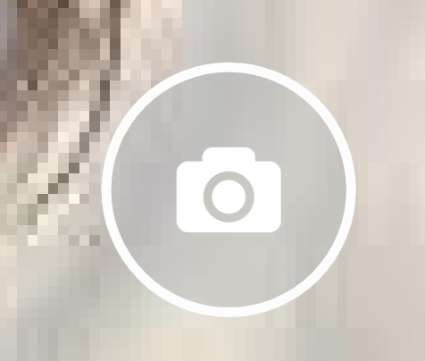
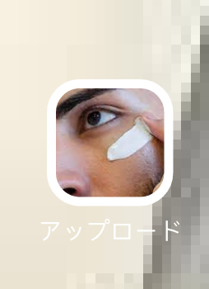
Filming and Editing
To access, users press the “+” on the home screen
Slide Up when accessed, slide down when “X” is pressed
”X” to close tab, light bulb to turn on light
(For selfie mode light, see next page)
Inverse Camera Button
Turn light on
Record/Take Photo Button
Select images from gallery option. Device’s gallery comes up

Slide 34
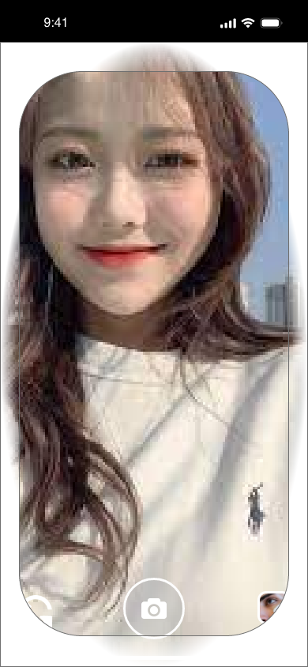
Filming and Editing — Selfie Light
Like the snapchat selfie light, when a user wants lighting for the inward camera, they press the light bulb once to bring out the ring light feature.
Fade all around (the image fails to represent it well)
Users press the light bulb again to turn the light off

Slide 35
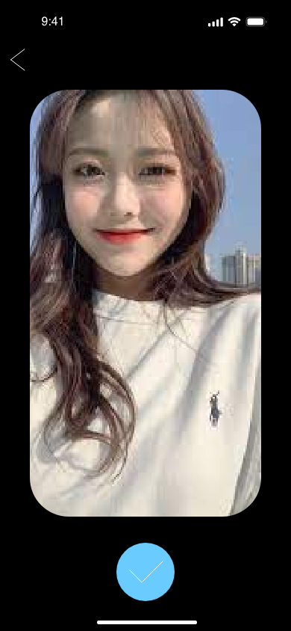
Filming and Editing — Image Confirmation
Slide in from right
Slide to the right when going back
Users confirm that they are happy with the photo
Back button on top left goes to the previous page
When users click the blue circle, they go to the video part of the live photo feature

Slide 36
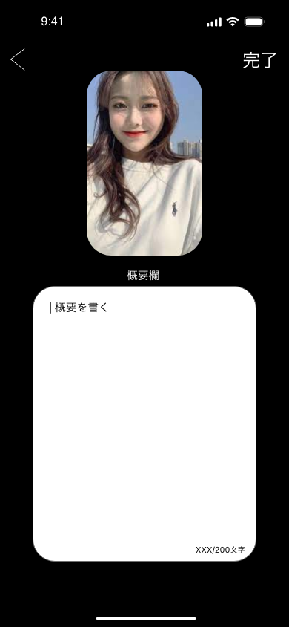
Filming and Editing — Content Confirmation
Slide in from the right to the left
Slide to the right when going back
Back button on top left
「完了」to finish
Users can write the description here (Max 200 characters)
When users click 「概要を書く」the keyboard appears

Slide 37
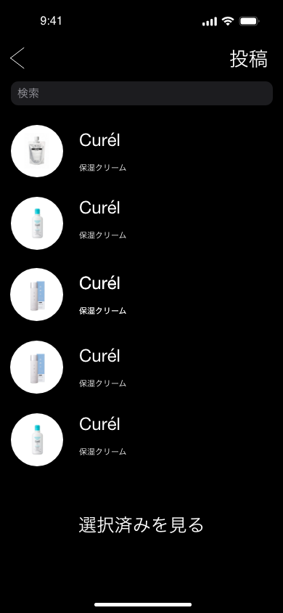
Filming and Editing — Product Selection
Slide in from the right to the left
Slide to the right when going back
Users select the product used in the content
「投稿」 to upload
Users search for a product, the first 3 product most fit to the search appears
If they want to look at more related products they press「続きを見る」 and the screen with a list of product appears
The products already selected appears in the 「選択済み」
By pressing 「続きを見る」users can see all of the products selected

Slide 38
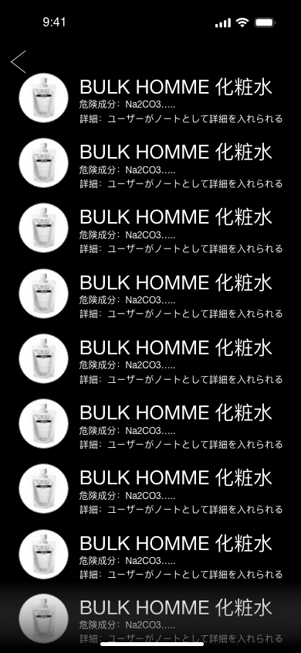
Filming and Editing — Product Selection Search
Slide in from the right to the left
Slide to the right when going back
Back button on top left
Users can view all products in the list by scrolling up and down
Products image, company name, product name
Dangerous substance at the bottom
When a user selects a product, the screen automatically goes back to the product selection home screen
Add a fade at the bottom

Slide 39
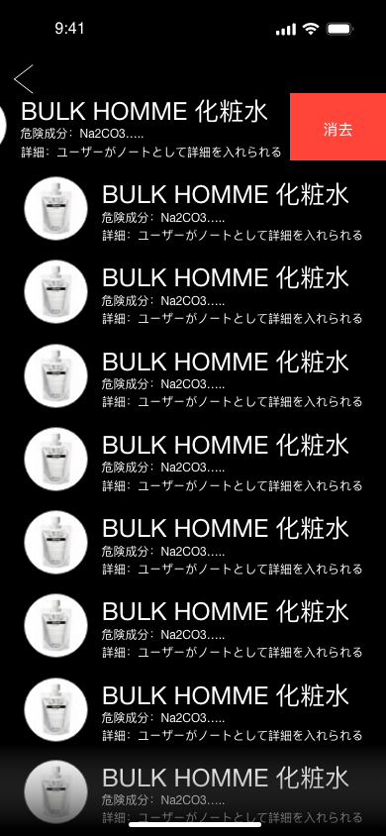
Filming and Editing — Product Selection Search
Slide in from the right to the left
Slide to the right when going back
Back button on top left
All of the selected products can be seen
Users can slide to the left of each product to remove it from the list

